Slide 1
LabVIEW DataGrid
An open source project to replace LabVIEW’s Table
Presenter: Mike King
Contact: mike.king@prolucid.ca

Slide 2
Project Reason and Purpose
LabVIEW’s Tables are very limited
DataGrids are a proven excellent solution for tabular data
.NET has a great DataGridView component
.NET containers in LabVIEW are fast and integrate well
Purpose is to therefore, provide a LabVIEW Table replacement with more capabilities that is much easier to use (by both developers and end users) than the native table.

Slide 3
LabVIEW Tables
Forced to Implement Manually
Additional cell data types
No word wrapping
Auto column resizing
Cell text wrapping
Column sorts and filters
All these are native to .Net DataGridView, no custom programming

Slide 4
What is DataGridView
A .Net control that provides a powerful and flexible way to display data in a tabular format.
Variable from simple read only to massive editable complex datasets
It’s common to all UI frameworks in all languages except LabVIEW
It uses additional .Net objects for it’s data and configuration
LabVIEW DataGrid makes use of this in LabVIEW with wrapper classes and objects to make data input and configuration of the grid simple

Slide 5
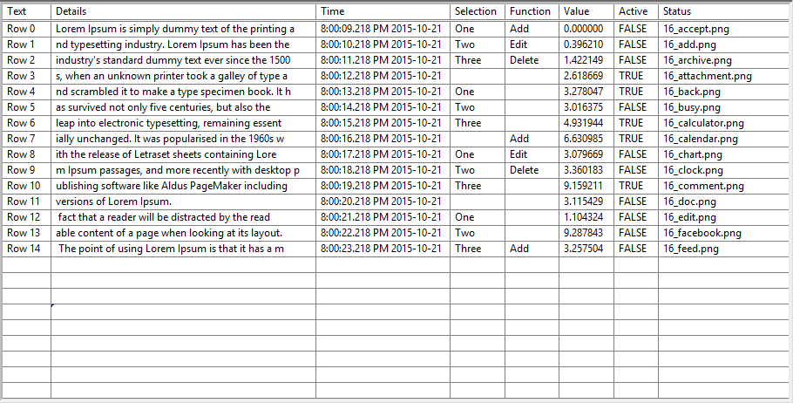
Lets Turn This Typical LabVIEW Table

Slide 6
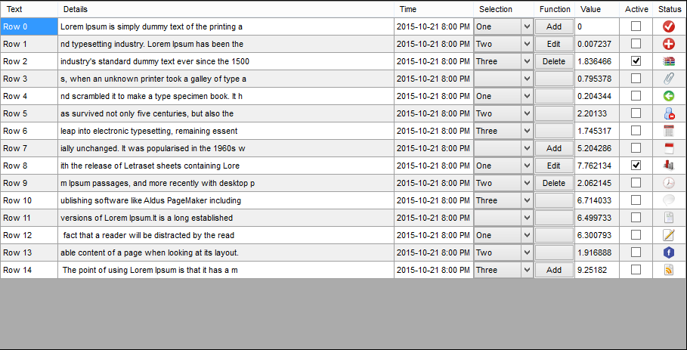
Into a more functional DataGridView

Slide 7
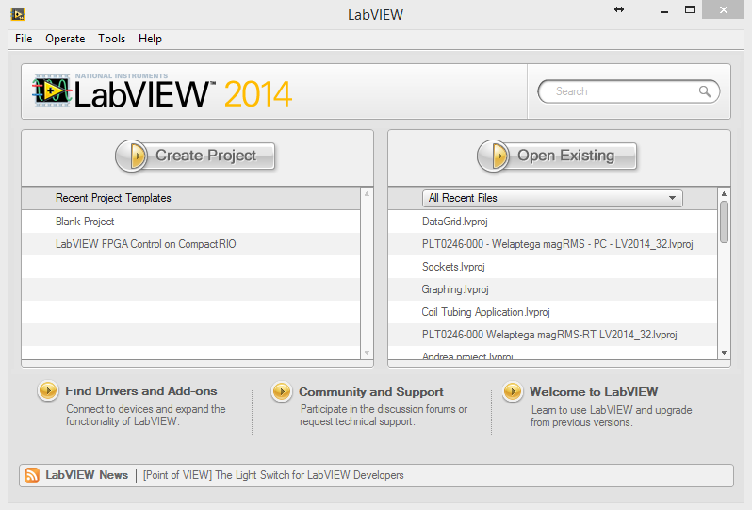
Demo the DataGridView

